Slide 1
程式設計實習(一)

Slide 2
rand()
#include <ctime>
…
srand(time(0));
int number = (rand() % 10) +1;
…

Slide 3
Recursion
A function that call itself, either directly, or indirectly.
When f(n) is difficult to evaluate, but can be evaluated by calculating f(m) (m<n).
  Can only solve a base case.

Slide 4
factorial
n! = n * (n-1) * (n-2) * … * 1
Recursive relationship:( n! = n * (n-1)!)
3! = 3 * 2!
2! = 2 * 1!
1! = 1 * 0!
Base case:1! = 0! = 1

Slide 5
factorial
unsigned long factorial( unsigned long n )
{
if ( n <= 1 )//base case
return 1;
else
return n * factorial( n - 1 );
}

Slide 6
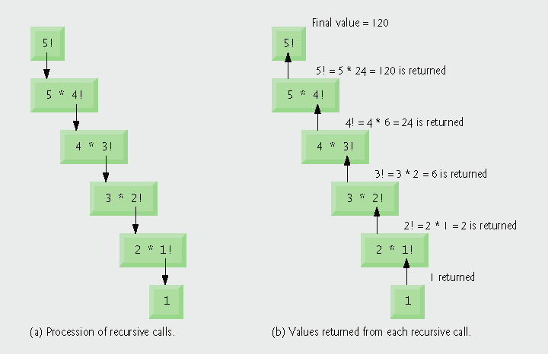
factorial

Slide 7
gcd
int gcd( int m , int n )
{
if ( n == 0 )//base case
return m;
else
return gcd( n , m % n );
}

Slide 8
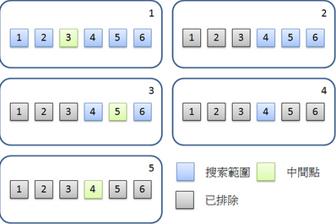
Hw 4
int BinarySearch(int A[],int key,int left,int right )

Slide 9
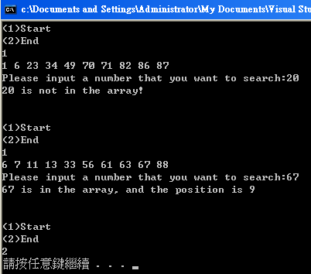
Hw 4

